Slide 1

Strigolactone Analogues and its effect on apoptosis
Arun Jairam, Joel John, Ammar Abdullah
11/23/21

Slide 2
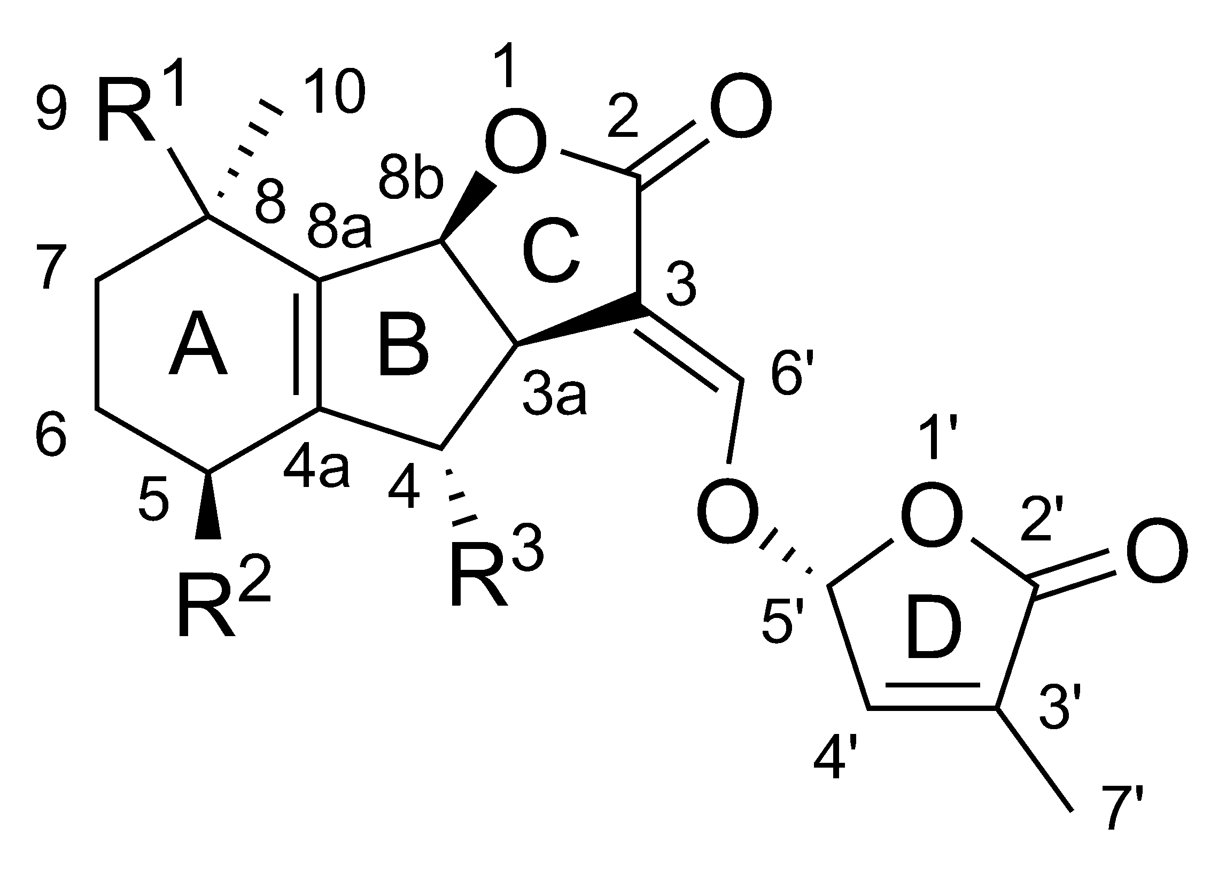
Introduction
This project deals with strigolactone analogues and their effect on cell growth on normal cells compared to when they don’t have strigolactone analogues.
The data in this project consists of samples of normal cells, one set that was a control group and one that was dissolved in strigolactone analogues, specifically ST-362 and the amount of RNA each of the samples have made after a six-hour time period.

Slide 3
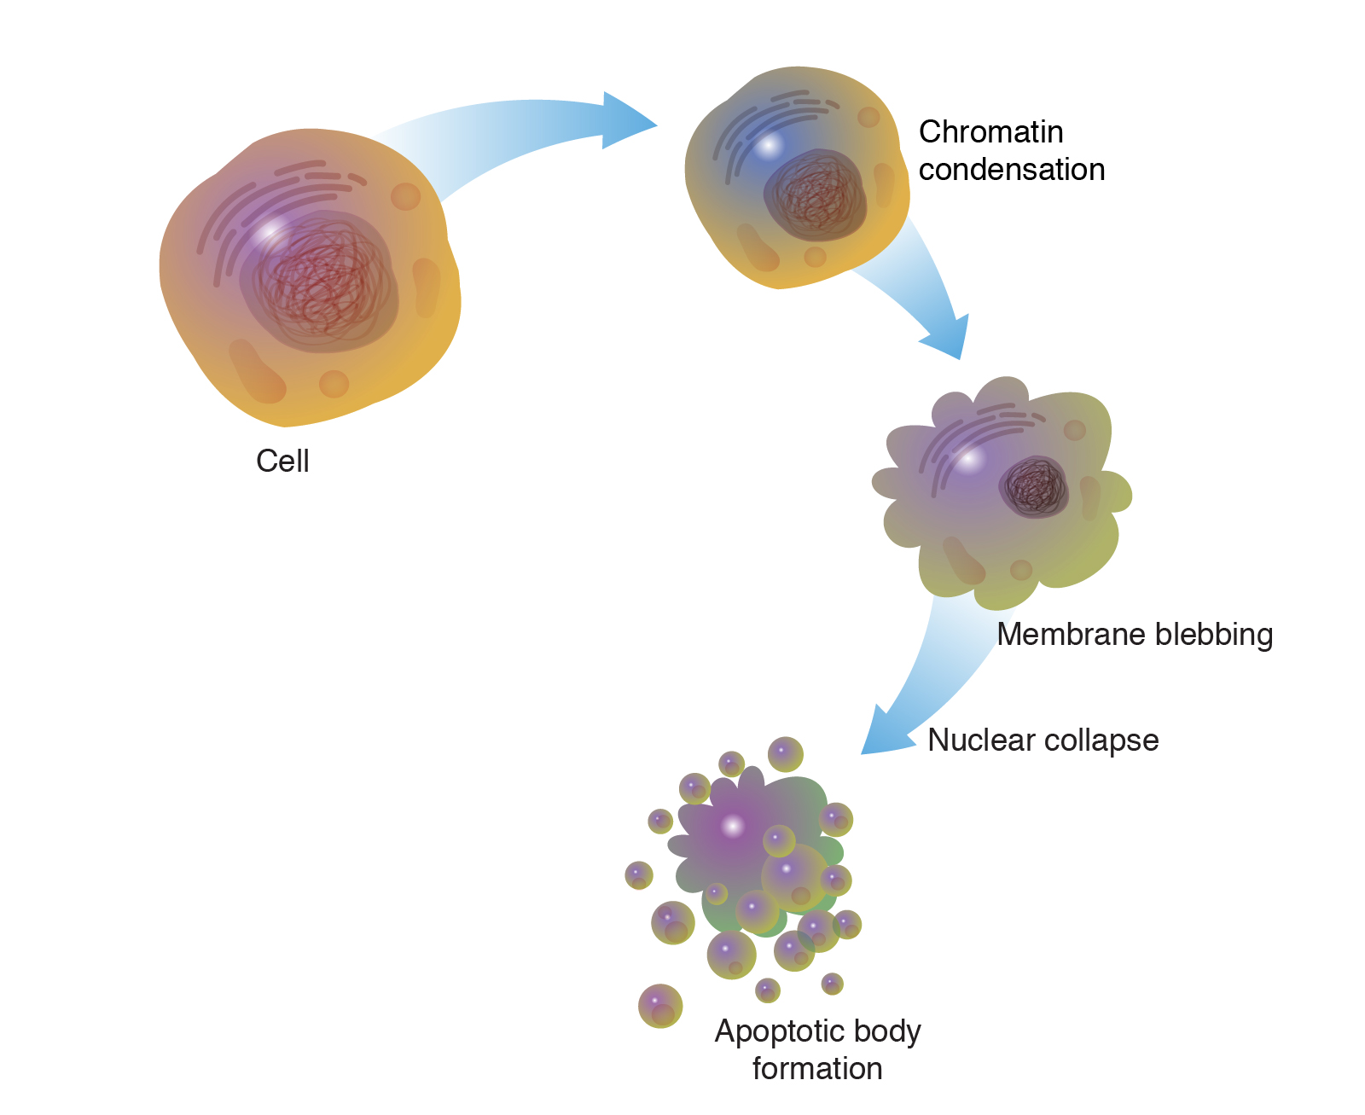
Hypothesis
The original hypothesis was that it could be determined how the amount of strigolactone analogues in a cell can affect its rate of apoptosis and that it wouldn’t affect normal cells substancially if they were given that.
This hypothesis came through looking at previous test results and findings that used strigalactone analogues and how they were used against cancerous samples of strains and theorizations of what it would do against normal cells.
Along with this, the fact that previous tests of strigolactone analogues have proved similar results on non-cancerous cells supports this argument.

Slide 4
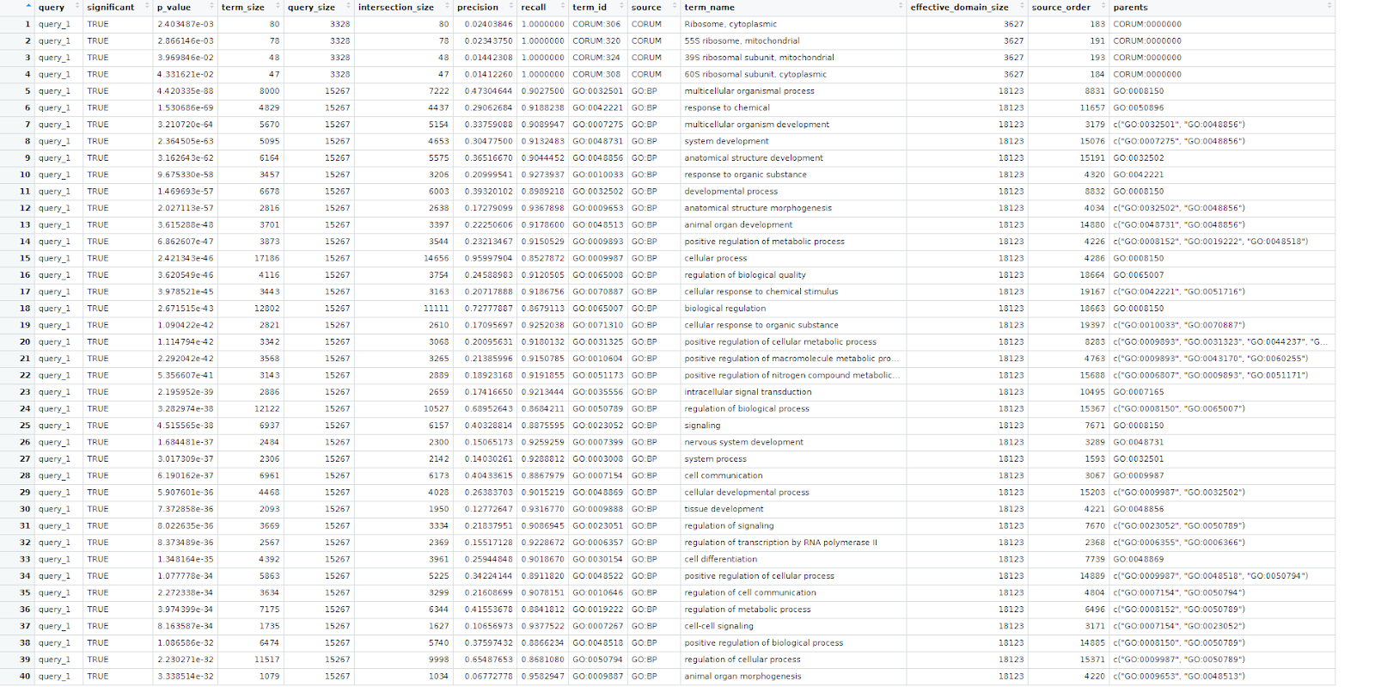
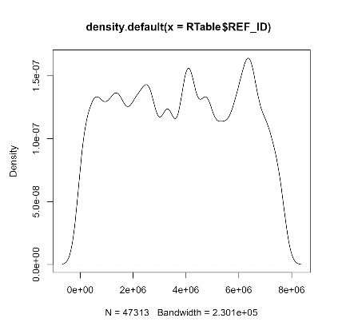
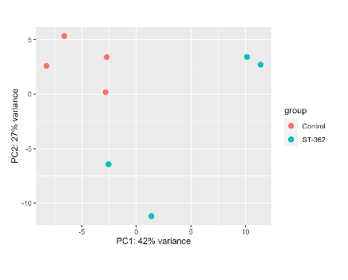
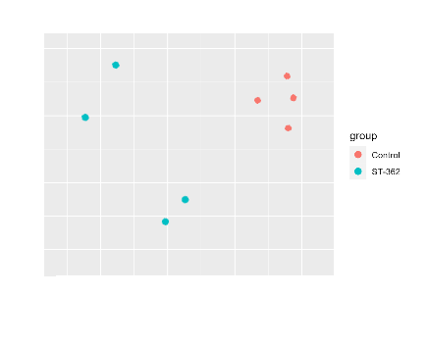
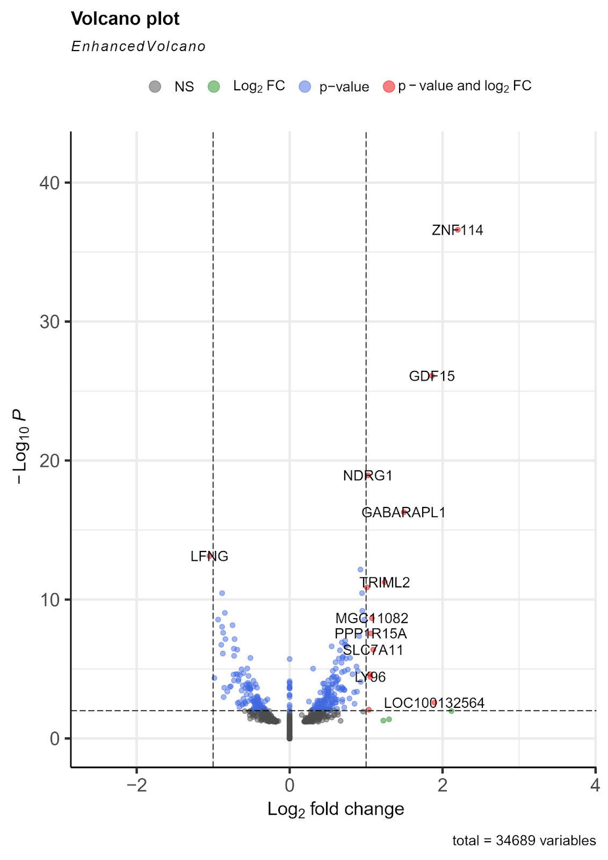
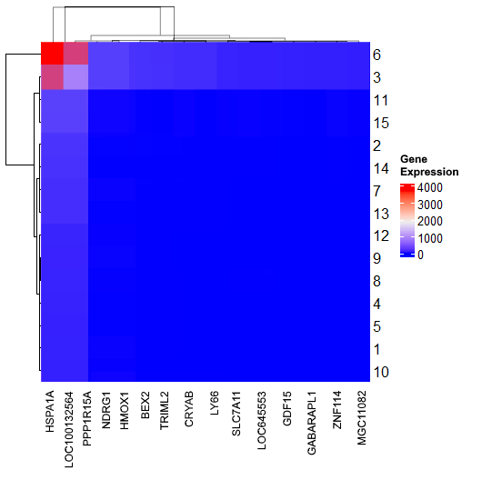
Differential Expression and Enrichment Analysis
With the density plot, plotting the density of each sample, it was shown that there is a lot of variation between each test but not so much between datasets proving the lack of variation between the growth of the cells.
The PCA plot and UMAP plots, that show the variance in the samples, showed that the ST-362 samples and the control samples had little variance between each other, proving the hypothesis
The volcano plot showcasing the relationship between the fold changes of the genes and its p values, had most of its data centered around zero, proving the hypothesis by showcasing the small variance between the samples.
The heatmap of the most significantly expressed genes, showcasing how much gene expression the 14 most significantly expressed genes had, showcased that there was only one outlier in terms of gene expression compared to the other most significantly expressed genes, proving that the samples weren’t much different in terms of expression.
The gProfiler2 Enrichment analysis, to find the gene ontology enrichment analysis, showcased that the gene sets used in the analysis were rather varied in terms of frequency and were therefore a good test for of strigolactone analogues
The overall findings of the differential expression and enrichment analysis was that there was a small amount of variation between the datasets and that the genes were varied in frequency
This proves the hypothesis because it showcases that the amount of RNA made between the two datasets don’t vary much between them and that the tests cover a wide variety of genes.

Slide 5


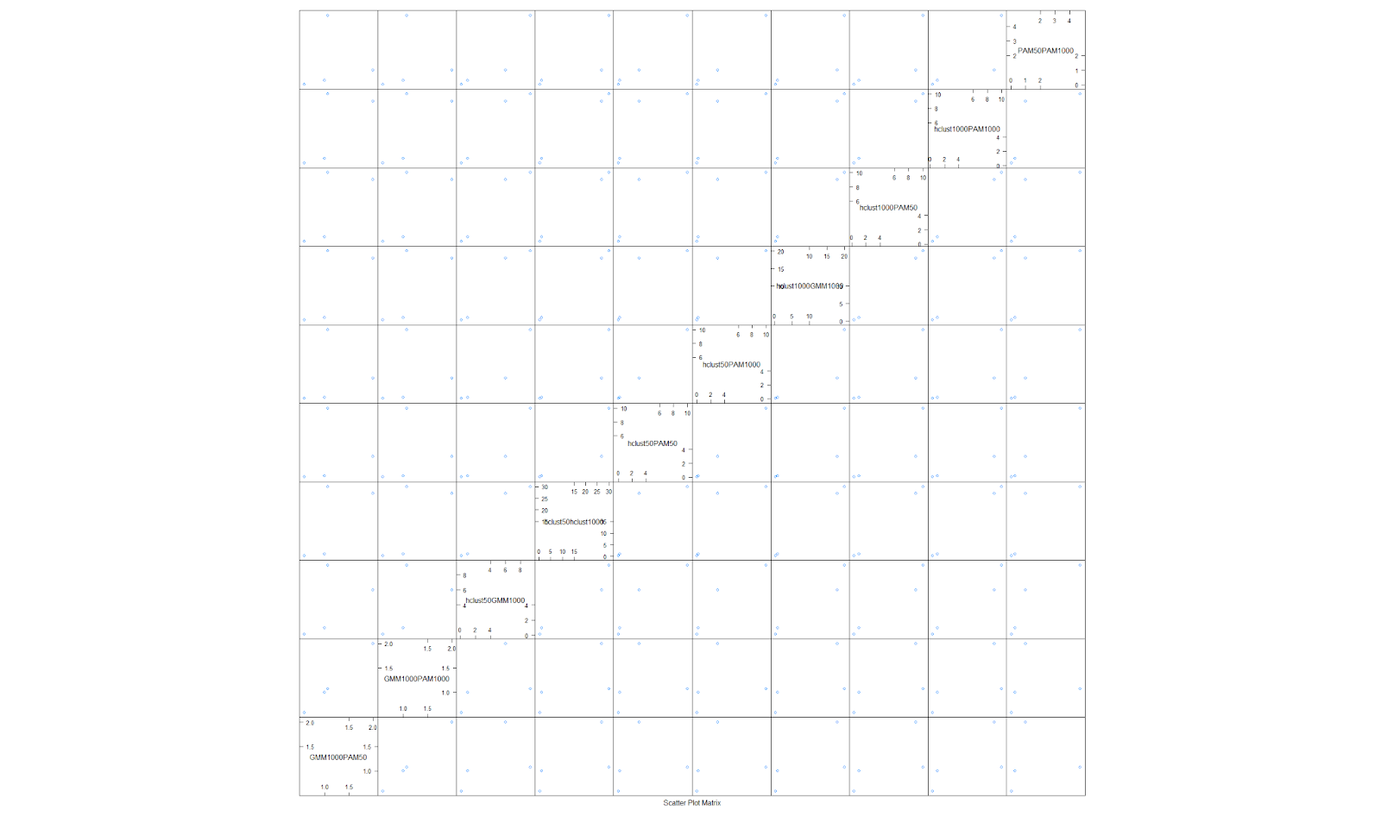
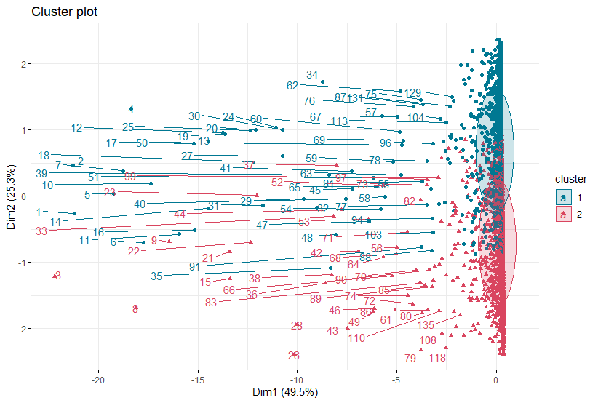
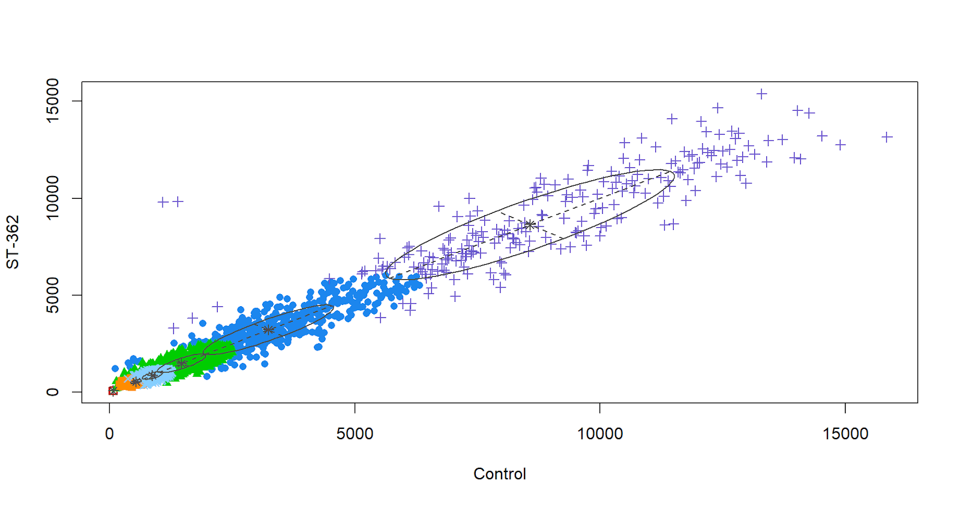
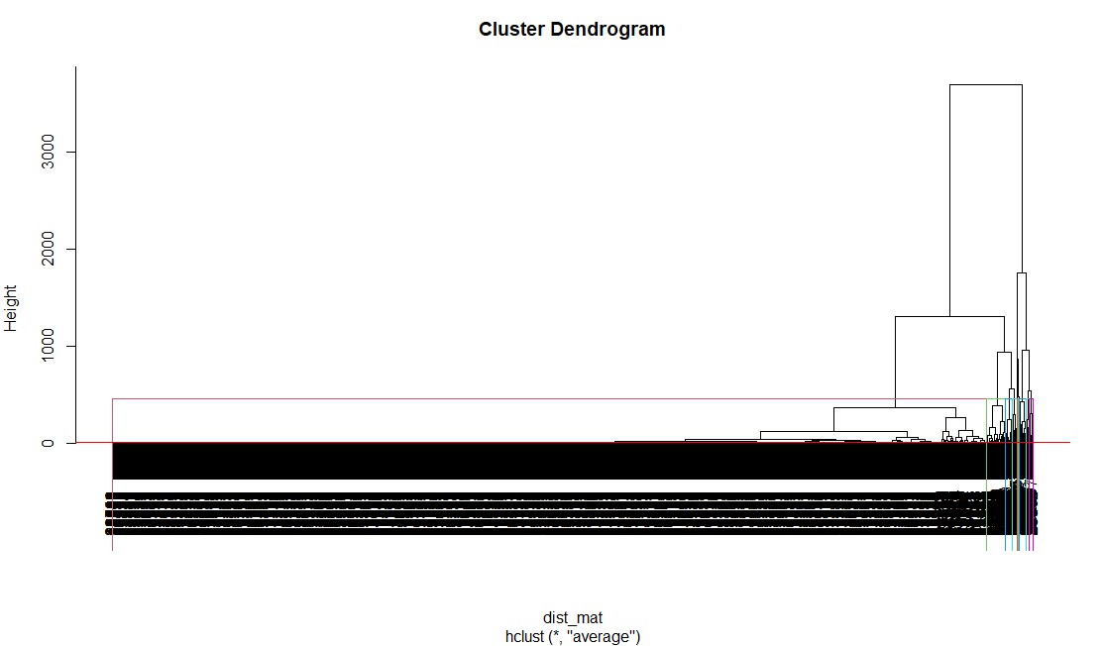
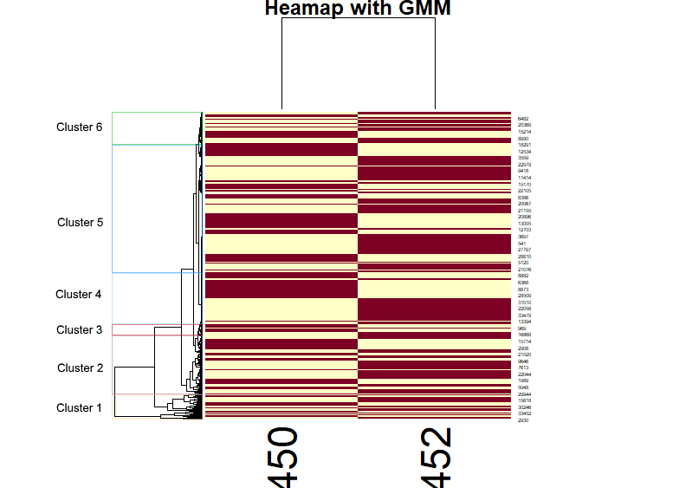
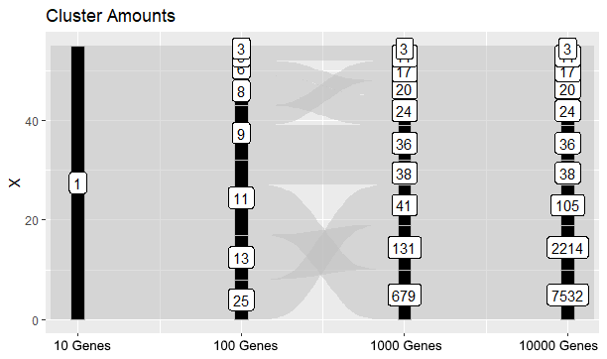
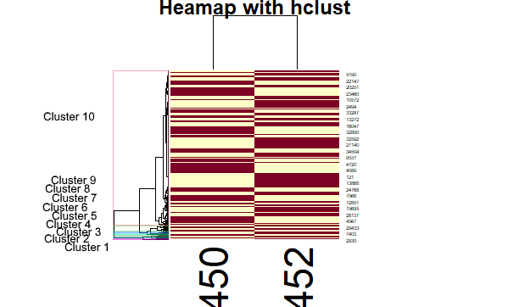
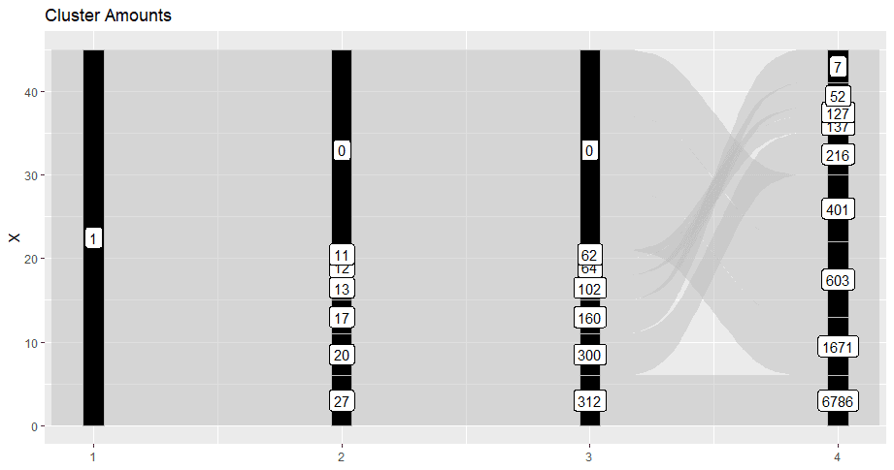
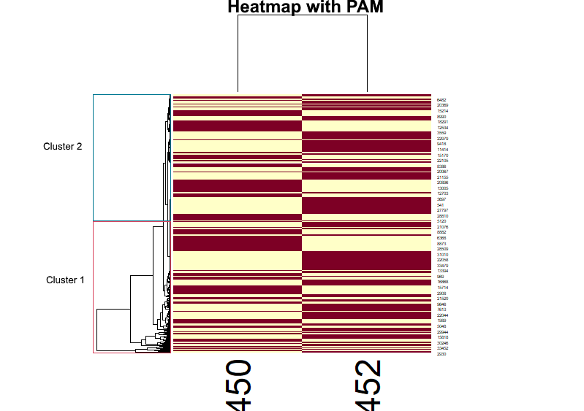
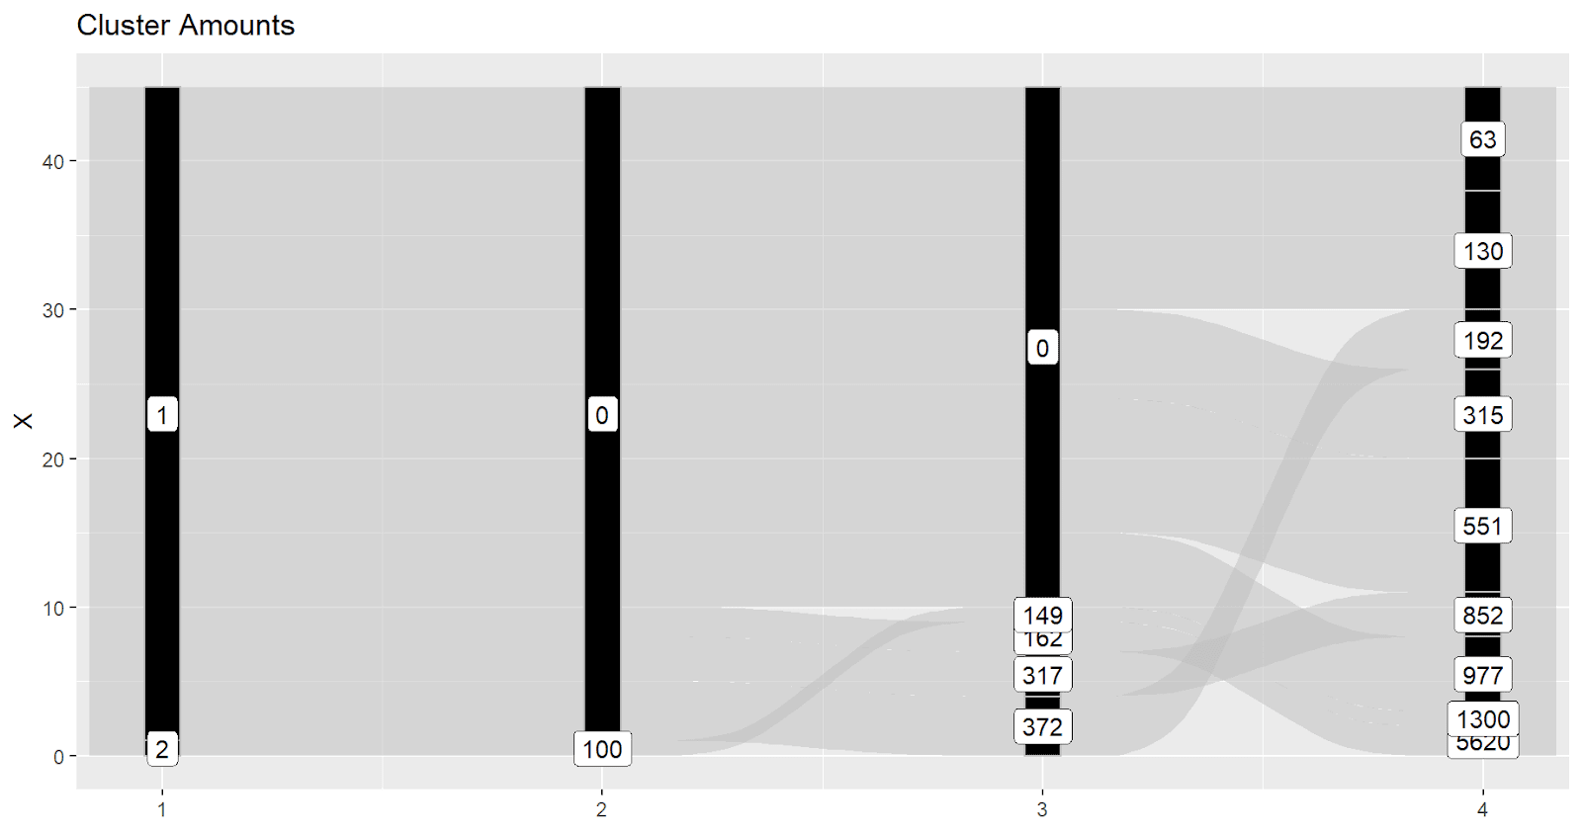
Clustering & Enrichment Analysis
The Hclust method used a Euclidian method to sort the matrix of the 5000 most variant genes and cluster them.
The clusters varied in terms of the amount of genes within them.
The ones with the most variance had smaller clusters and the ones with least variance have larger clusters
The alluvial diagram showcased no real change in clustering comparing 10, 100, 1000 and 10000 genes
The Heatmap of the variant genes showed similar clustering to the Hclust method itself
The PAM method finds medoids, which are unique centers of data used to base clusters and then creates a graph of them
Two clusters were used with this method and a similar amount of genes are within them
The alluvial diagram showed that the amount of genes in the cluster became lopsided when comparing 10, 100, 1000 and 10000 genes
The heatmap of the variant genes showed similar clustering to the PAM method itself
The GMM method made a scatterplot of all the data points and made clusters.
Because they are linearly aligned with one another, it indicates that the control and variable groups have fairly similar values
The alluvial diagram showcased several 0 gene clusters when comparing 10, 100, 1000 and 10000 genes
The Heatmap of the variant genes showed similar clustering to the Hclust method itself
After performing Chi Squared tests, PAM and GMM showed little relation with the clusters while the Hclust method showcased a big relation with them.
After comparing hclust, GMM and PAM with each other, the methods are fairly similar with one another in determining the clusters
This proves that the hypothesis is supported by showcasing that, even when clustering with variance, the only ones with massive variance are outliers and that the majority of them were clustered together showing little variance.

Slide 6

Conclusions & Future Work
From this project, the conclusion formed is that strigolactone analogues do not affect the growth of normal cells in any drastic way
This is important as it paves the way for future use in anticancer research.
In terms of doing things differently, we could have done more enrichment analysis with the differential expressions
Would have also organized the data earlier
One question that we have in regards to our project data, is how they would work on human cells that aren’t used in separate samples and, instead, working on actual people.

